Slide 1
Electromagnetic Stirring of Liquid Metals
Yash Ganatra (10BME 1043)
Internal Guide : Dr. Jayasankar Variyar
External Guide: Dr. Pramod Kumar
(May 2014)

Slide 2
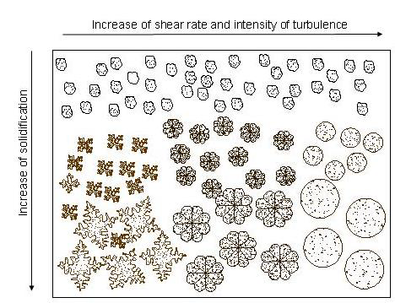
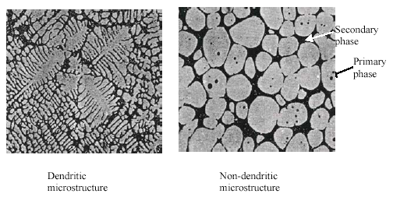
“Science” behind semi-solid forming
Directional solidification → dendritic microstructure:
→ defects such as inhomogeneity, cracks, porosity….
“Fragmentation” or detachment of dendrites during solidification can lead to non-dendritic microstructure.
Fragmentation influences macrosegregation and microstructure
Experiments carried out at ESRF, Grenoble
Directional solidification (bottom cooled) of Al-20 wt.% alloy.
Detachment of dendrites can be enhanced by forced convection such as EM stirring

Slide 3
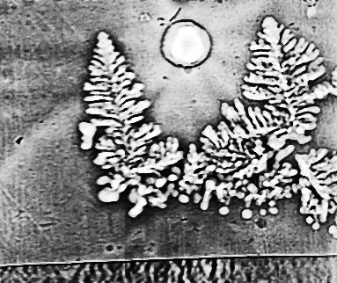
“Science” behind semi-solid forming……cont.
Automotive, aerospace, defence, structural
SSF components:
increased strength
no porosity
no solidification shrinkage
thin wall sections
low machining costs
Reheated billet can be used in a die-casting machine to produce near net-shape components.
Detachment of dendrites observed by Synchrotron X-ray Imaging (Arnberg and Mathiesen, 2006, NTNU, Norway)

Slide 4
Methods of producing non-dendritic microstructure
Passive methods
No dendrite shear only suppress the growth and formation
Low superheat pouring
Addition of grain refiners and modifiers to generate equiaxed growth
Active methods
Rely on Dendrite fragmentation due to forced convection
Dendrite fragmentation methods
Intrusive methods
Mechanical stirring
Impellors/Twin screw
Drum Rollers
Cooling slopes
Non-Intrusive methods
Ultrasonic vibrations Electromagnetic stirring

Slide 5
Literature review
Most literature focus
Rheological behavior of semisolid slurries.
Post processing of semisolid billets into components.
Reheating, heat treatment, Alloy development etc. Microstructure characterization.
Mechanical property characterization.
(tensile strength, fracture toughness, compression tests)
Extensive research on generating non-dendritic microstructure
mostly mechanical stirring
Electromagnetic (EM) stirring (generally rotary types)
Linear EM stirring (LEMS) widely accepted as most effective
No Literature on EM stirring using LEMS

Slide 6
Contribution
Development of model of Linear Electromagnetic stirrer using ANSYS FLUENT
Bottom Up Approach for design
Development of
A-V formulation in FLUENT
Validating code for infinitely long cylindrical current carrying conductor
Validating code for square bar
Necessity for development of A-J formulation in FLUENT
Development of A-J formulation in FLUENT
Validating code for a circular coil
Validating code for solenoid subject space and time varying current densities

Slide 7
Contribution (contd.)
Current entry
Modeling LEMS as a set of 3 coils
Modeling LEMS as a set of 6 coils
Foundation for design of LEMS
Current exit
I_{A}
I_{C}^{I}
R
L/6
I_{B}
H(z_{P},r_{p})
r_{P}
L
I_{A}^{I}
I_{C}
z_{P}
I_{B}^{I}
(a)
(b)
(a) Coil arrangement in a two pole in a LEMS. (b) Phasor notation of currents.

Slide 8
Working Principle
The principle of working is similar to that of a linear induction motor. Electrically it is a two pole motor.
Circular Coils → Stator winding , Liquid Metal → Rotor
The coils are displaced in space by 120º. 3 phase currents
produce travelling magnetic field along axis of coil.
This varying field induces voltage in the molten metal in the tangential direction. The induced voltage establishes tangential eddy currents in the liquid metal.
The eddy current(tangential) in the liquid metal and the magnetic field(radial and axial) produce forces(axial and radial) in the liquid metal. These forces set the liquid metal into motion.

Slide 9
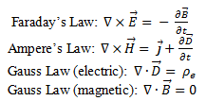
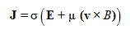
EM stirring- How it works ??
Solenoid coil
E is the electric field V/m
B is the magnetic flux density Wb/m²
H is the magnetic field intensity A/m
J is the current density A/m²
μ is the permeability of the metal H/m
σ is the conductivity S/m
v is velocity of the fluid m/s
H(z,r)
L
J_{p}(A/m)
z
r
Field space
R
Metals -electrically conducting
Induced currents, magnetic fields ⇒ Lorentz Force
Applications
grain refinement.
Mix immiscible liquid metals
Solenoid excited by an alternating current
Advantages
Non intrusive i No contamination.
Current and frequency i Control of stirring intensity, process.
Orientation and direction of primary current
Key parameters in generating the forces in desired direction.
Notes:
A sinusoidal distribution of mmf along the axis of the coils is achieved when the coils are displaced in space by 120. When these space displaced coils are excited by three phase currents, the resulting mmf is sinusoidally distributed in space as well as time.

Slide 10
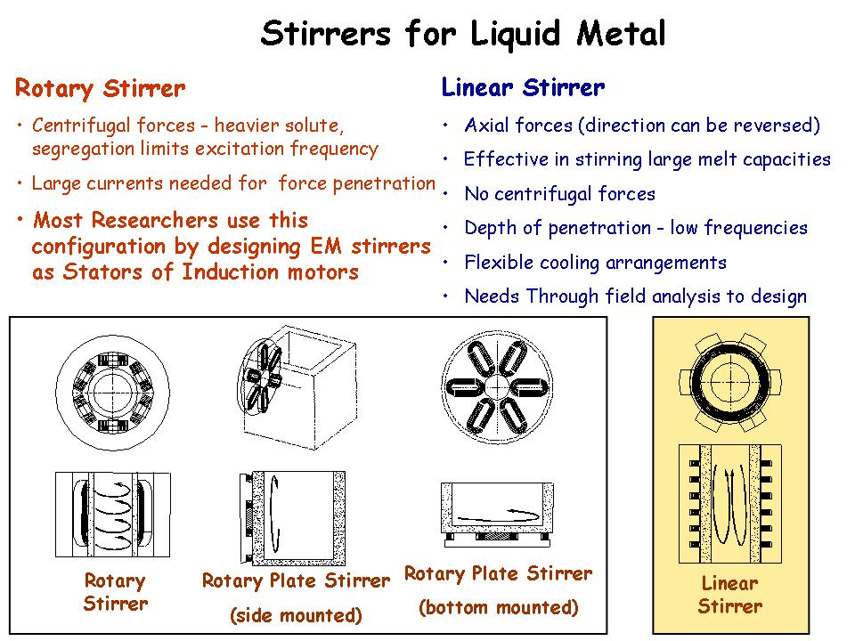

Slide 11
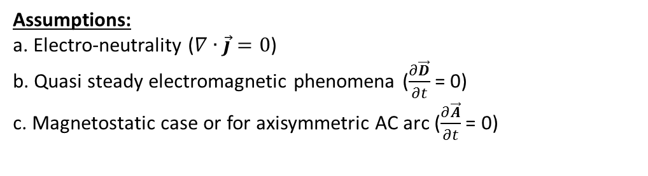
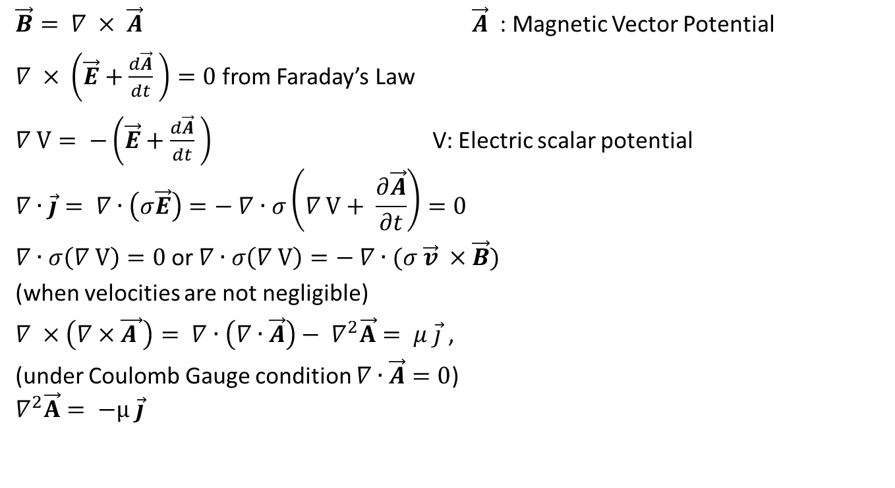
Field Formulation (A-V)
$\vec{B}= ∇ × \vec{A} \vec{A}$: Magnetic Vector Potential
$∇ × \left(\vec{E}+\frac{d\vec{A}}{dt} \right)=0$ from Faraday’s Law
$∇ V= −\left(\vec{E}+\frac{d\vec{A}}{dt} \right)$ V: Electric scalar potential
$$∇∙\vec{j}= ∇∙\left(σ\vec{E}\right)=− ∇∙σ\left(∇ V+ \frac{∂\vec{A}}{∂t}\right)=0$$
$∇∙σ\left(∇ V\right)=0$or $∇∙σ\left(∇ V\right)=− ∇∙(σ \vec{v} ×\vec{B})$
(when velocities are not negligible)
$∇ ×\left(∇×\vec{A }\right)= ∇∙\left(∇∙\vec{A}\right)− ∇^{2}\vec{A}= μ \vec{j}$ ,
(under Coulomb Gauge condition $∇∙\vec{A}=0$)
$$∇^{2}\vec{A}= −μ \vec{j}$$
Assumptions:
a. Electro-neutrality ($∇∙\vec{j}=0$)
b. Quasi steady electromagnetic phenomena ($\frac{∂\vec{D}}{∂t}$ = 0)
c. Magnetostatic case or for axisymmetric AC arc ($\frac{∂\vec{A}}{∂t}$ = 0)

Slide 12
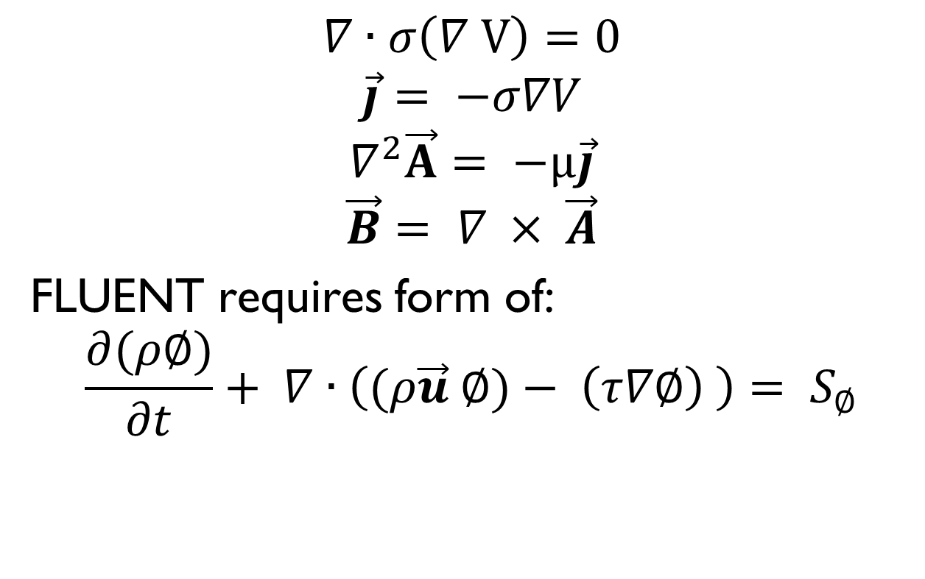
Simplified Equation Set
$$∇∙σ\left(∇ V\right)=0$$
$$\vec{j}= −σ∇V$$
$$∇^{2}\vec{A}= −μ\vec{j}$$
$$\vec{B}= ∇ × \vec{A}$$
FLUENT requires form of:
$$\frac{∂(ρ∅)}{∂t}+ ∇∙\left((ρ\vec{u} ∅)− \left(τ∇∅\right) \right)= S_{∅}$$
Unsteady Term
Flux Term
Diffusion Term
Source Term

Slide 13
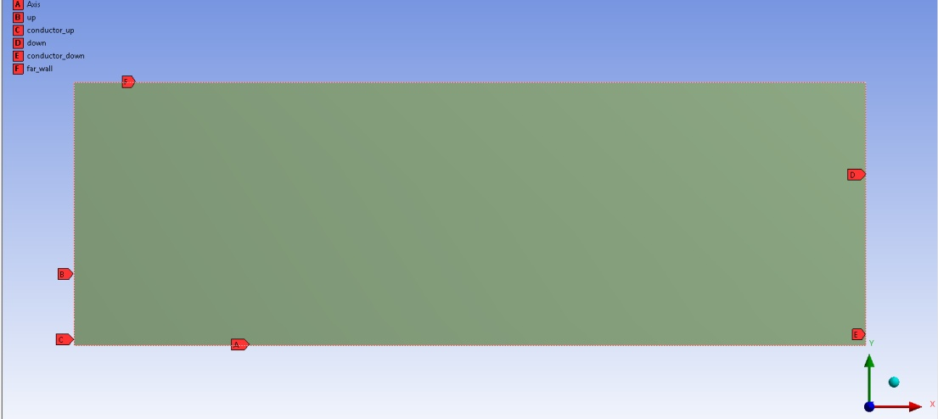
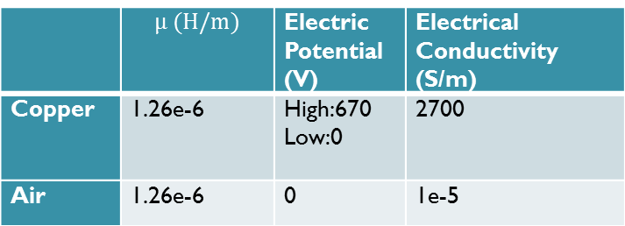
Validation 1 – Magnetic field around cylindrical current carrying conductor
Named Selections
Geometry from 3D to 2D axisymmetric
Boundary Conditions
 | A(V.s/m) | V (V)
Conductor_up | Zero normal gradient | 670
Conductor_down | Zero normal gradient | 0
Up | Zero normal gradient | Zero normal gradient
Down | Zero normal gradient | Zero normal gradient
Far_walls | Zero value | Zero normal gradient
Axis | Axis | Axis
 | $$μ (H/m)$$ | Electric Potential (V) | Electrical Conductivity (S/m)
Copper | 1.26e-6 | High:670 Low:0 | 2700
Air | 1.26e-6 | 0 | 1e-5
Material Properties

Slide 14
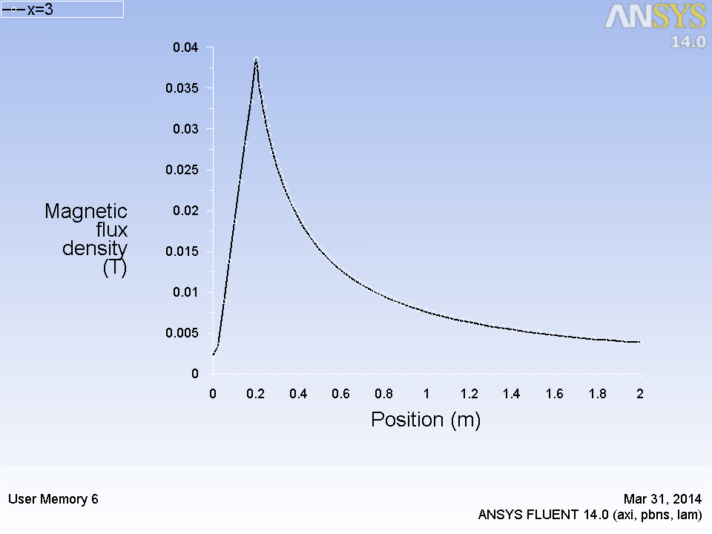
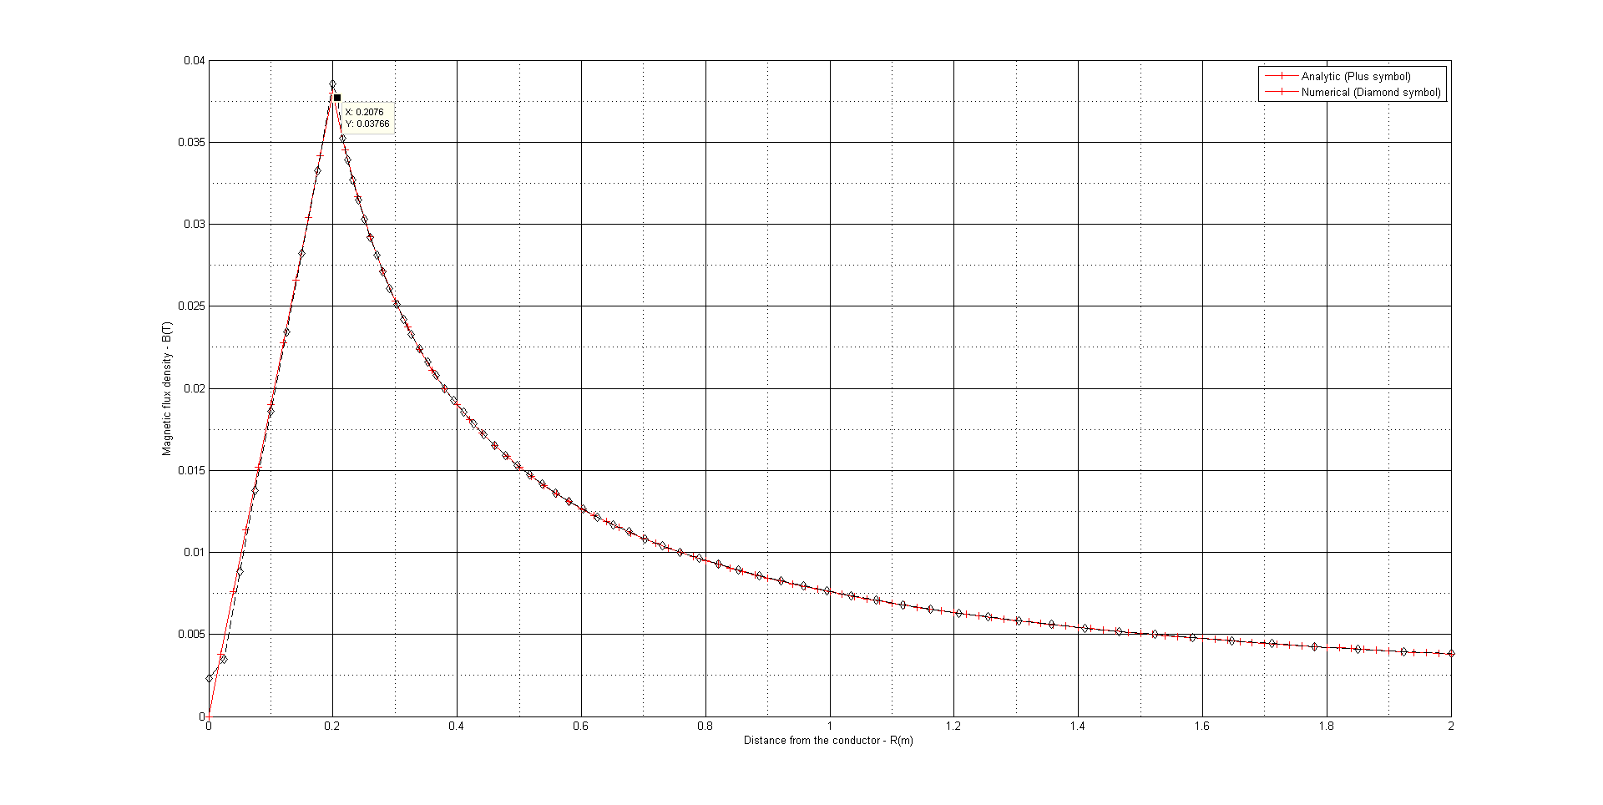
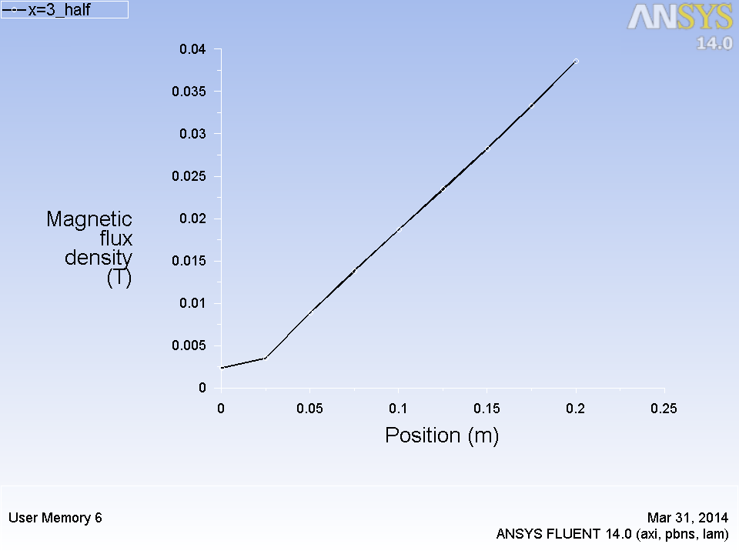
Results
(a)
(b)
(a): Line plot of magnetic field from FLUENT
(b): Comparison of line plots obtained from FLUENT and the analytical solution obtained in MATLAB
(c): Magnetic field inside the conductor
(c)

Slide 15
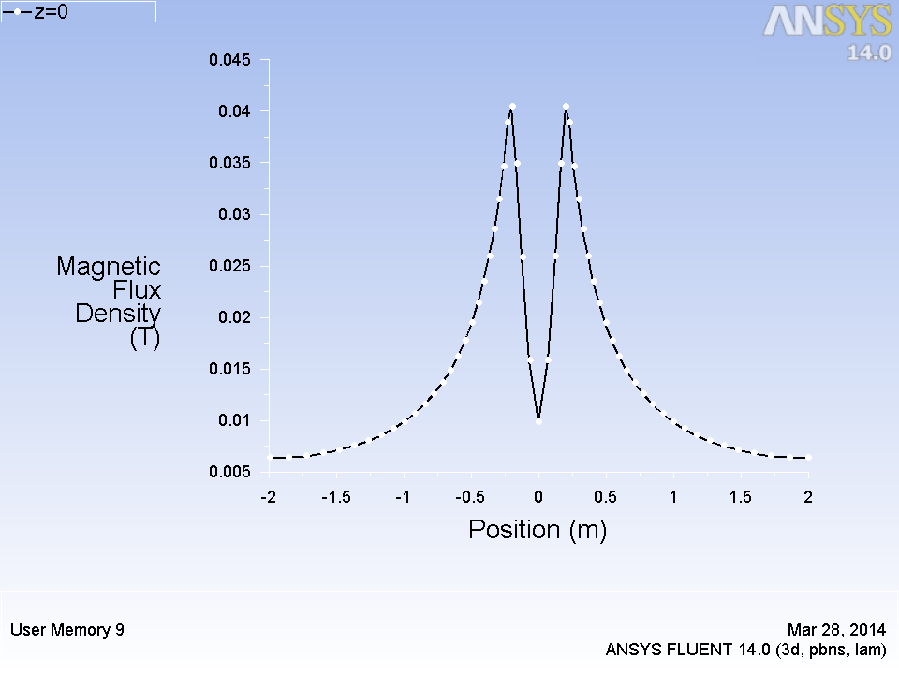
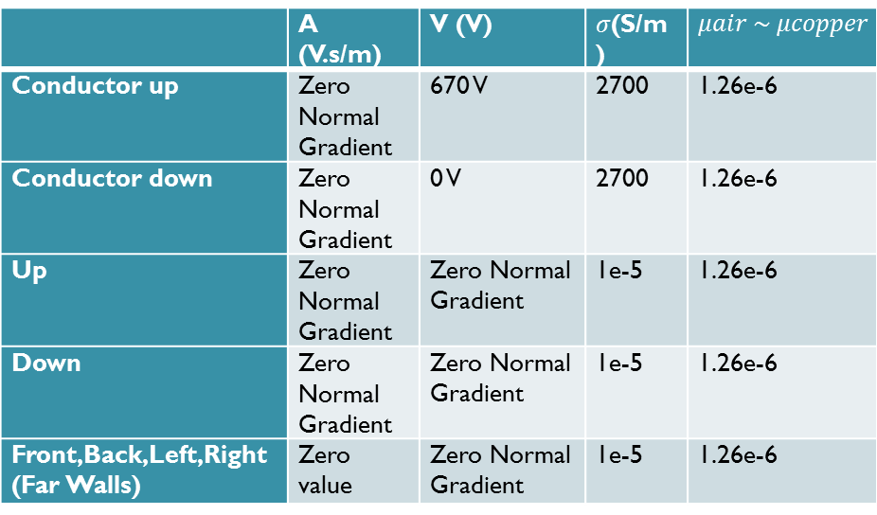
Validation 2 – Magnetic field around current carrying bar
Geometry of bar
Boundary Conditions
 | A (V.s/m) | V (V) | $σ$(S/m) | $$μair \sim μcopper$$
Conductor up | Zero Normal Gradient | 670 V | 2700 | 1.26e-6
Conductor down | Zero Normal Gradient | 0 V | 2700 | 1.26e-6
Up | Zero Normal Gradient | Zero Normal Gradient | 1e-5 | 1.26e-6
Down | Zero Normal Gradient | Zero Normal Gradient | 1e-5 | 1.26e-6
Front,Back,Left,Right (Far Walls) | Zero value | Zero Normal Gradient | 1e-5 | 1.26e-6
Line plot of magnetic field
along x at y=z=0

Slide 16
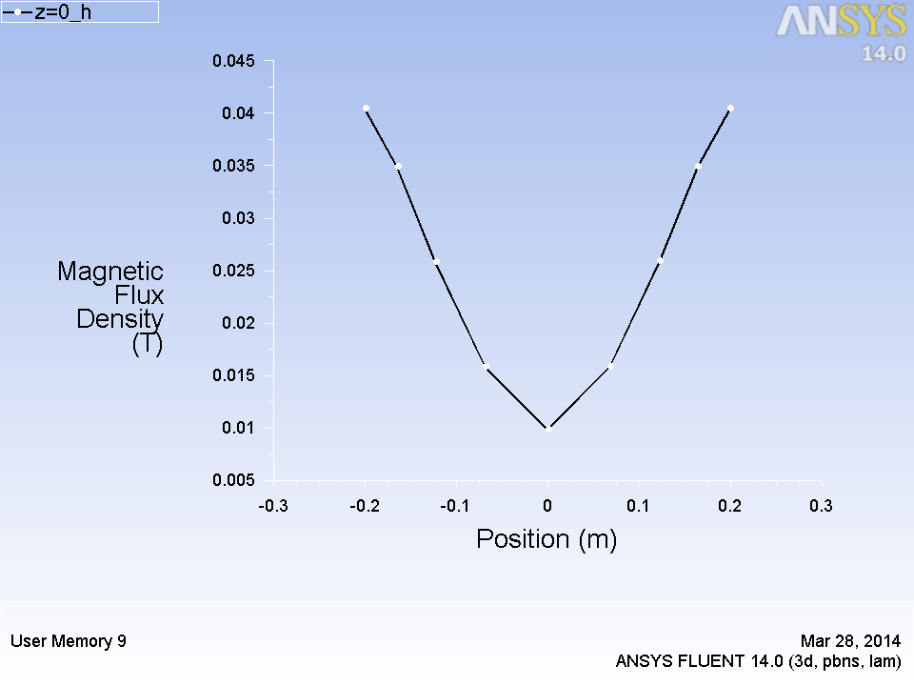
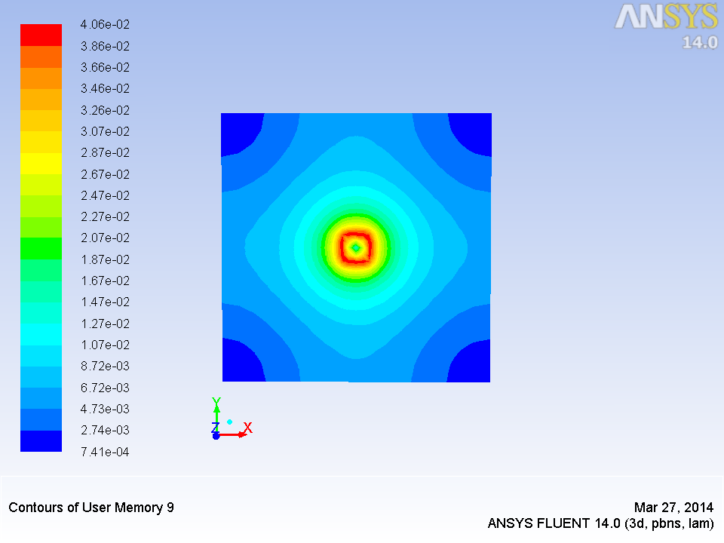
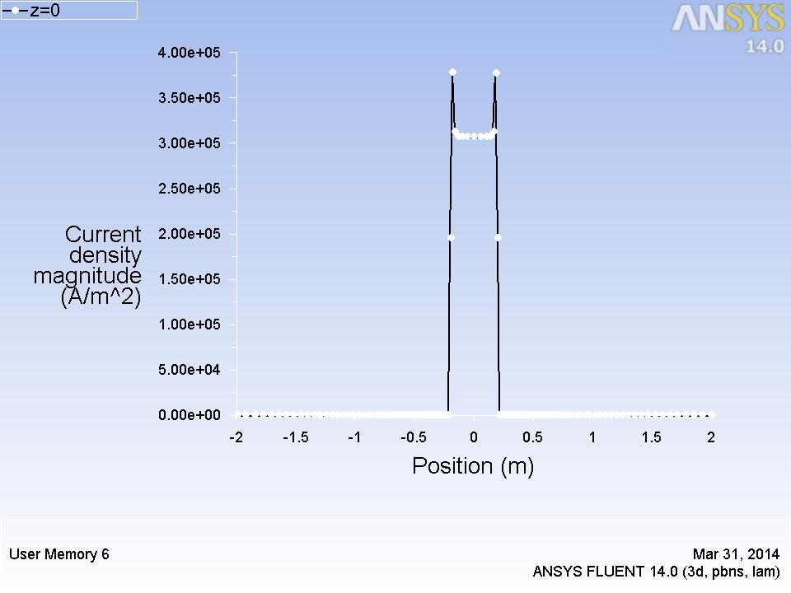
(a)
(a): Line plot of magnetic field inside the conductor
(b): Contour plot of Magnetic field from FLUENT
(c): Line plot of Current density magnitude along x at y=z=0
(b)
(c)

Slide 17
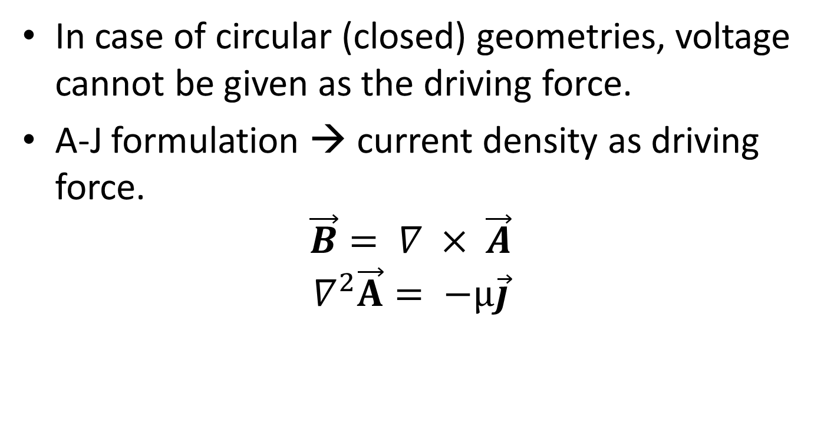
Field Formulation (A-J)
In case of circular (closed) geometries, voltage cannot be given as the driving force.
A-J formulation → current density as driving force.
$$\vec{B}= ∇ × \vec{A}$$
$$∇^{2}\vec{A}= −μ\vec{j}$$

Slide 18
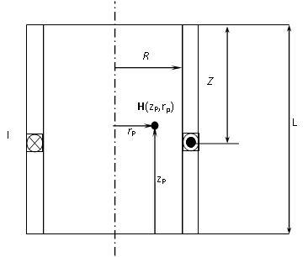
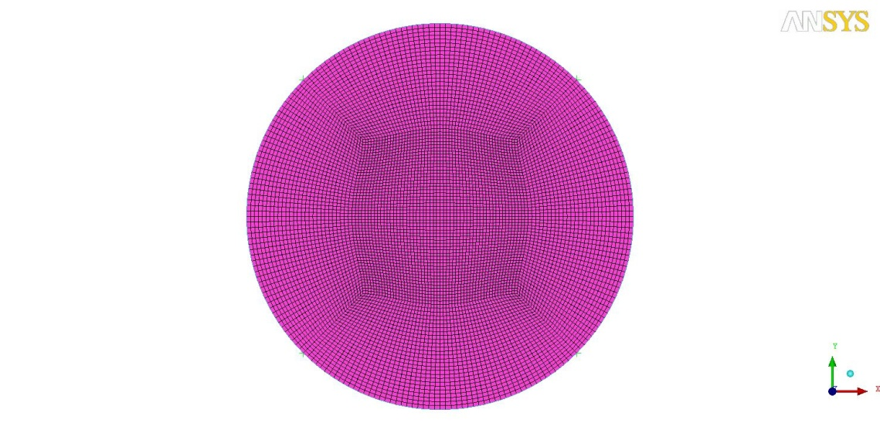
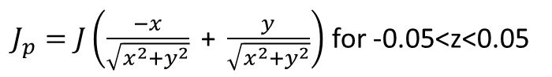
Validation 3 – Magnetic field around current carrying coil
Coil Geometry
Hex mesh of coil
Boundary Conditions
$J_{p}=J\left(\frac{−x}{\sqrt{x^{2}+y^{2}}}\text{ + }\frac{y}{\sqrt{x^{2}+y^{2}}}\right)$ for -0.05<z<0.05
Geometric properties of coil
 | A (V.s/m)
Up | Zero Normal Gradient
Down | Zero Normal Gradient
Far Walls | Zero Normal Gradient
Inner radius (m) | Outer Radius (m) | Mean Radii (m) | Thickness (m) | Magnetic Permeability (Wb/m)
0.038 | 0.042 | 0.04 | 0.01 | 1.26 e-6

Slide 19
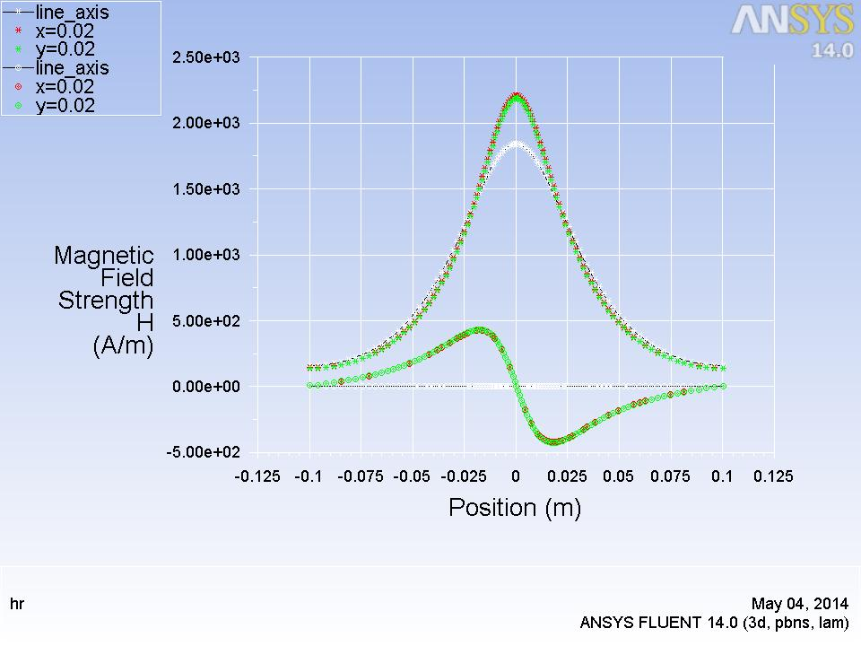
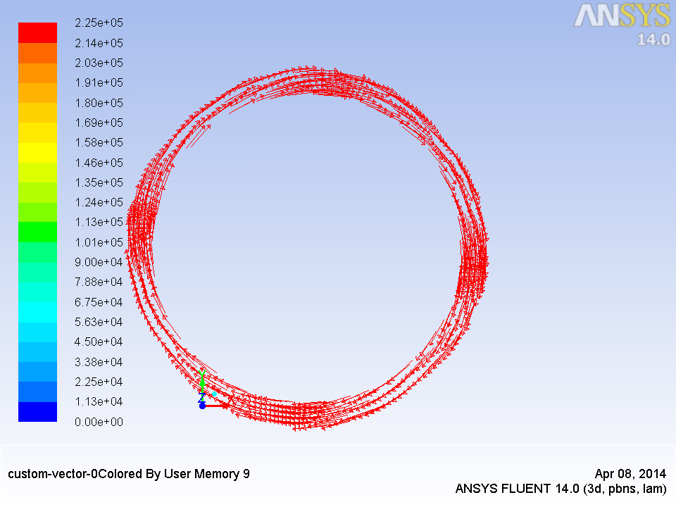
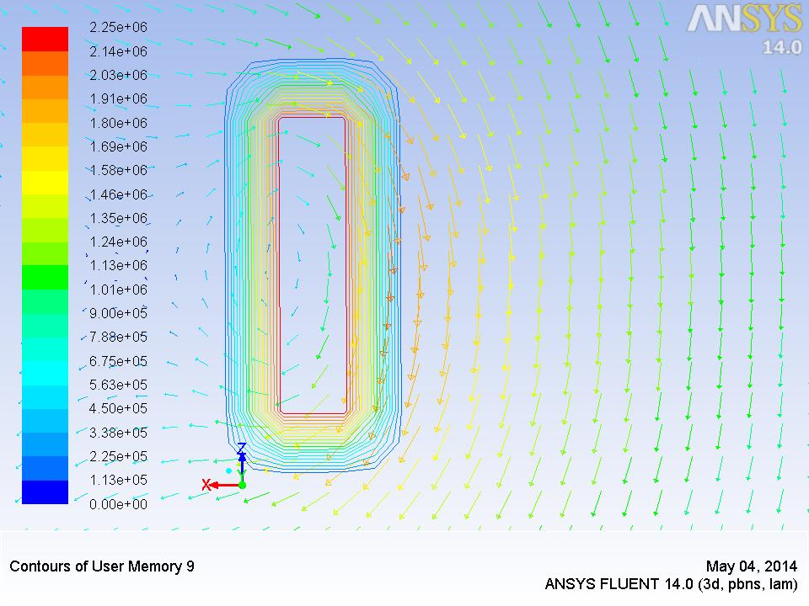
(a)
H_{z}
H_{r}
(a) Vectors of current density
(b)
(b) Axial Variation of Magnetic field strength
(c)
(c) Magnetic field vectors around a coil as seen
from top

Slide 20
Validation 4 – Magnetic field around current carrying solenoid
Solenoid Geometry
Constant Current
Space Varying Current
Time Varying Current
Space and time varying current
Geometric properties of solenoid
Inner radius (m) | Outer Radius (m) | Mean Radii (m) | Thickness (m)
0.038 | 0.042 | 0.04 | 0.2
Geometric properties of steel bar inside solenoid
Inner radius (m) | Outer Radius (m) | Centre | Thickness (m) | Relative Magnetic Permeability of bar (Wb/m)
0.0 | 0.02 | (0.0,0.0,0.0) | 0.1 | 2000

Slide 21
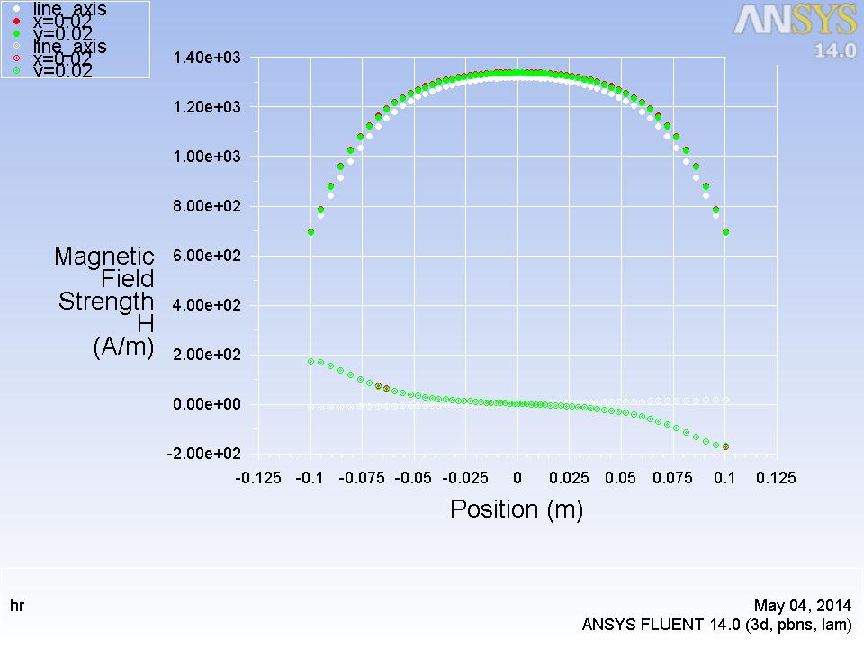
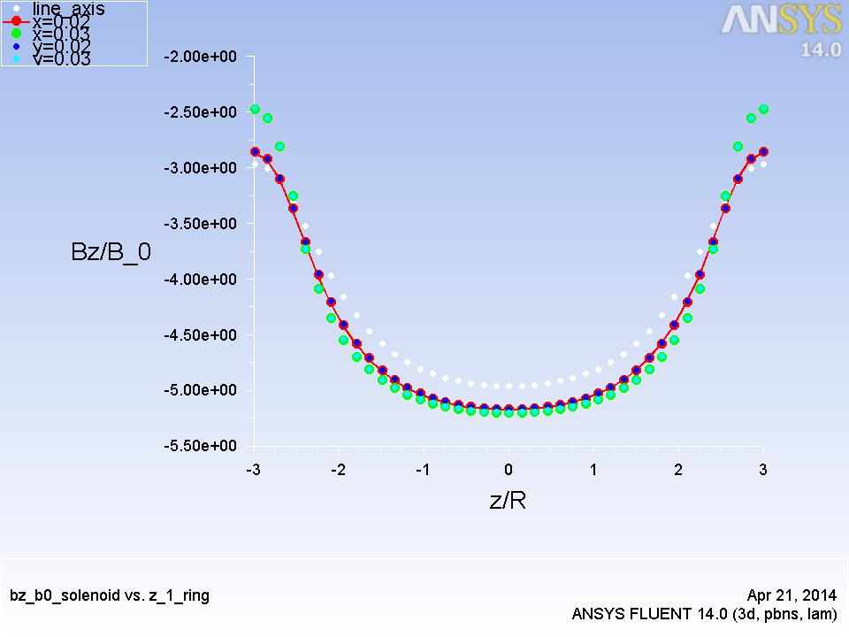
Solenoid – Constant Current
(a)
(b) Variation of Bz/B_{o} along
dimensionless quantity z/R
(b)
H_{z}
H_{r}
(a) Axial Variation of magnetic field strength
H_{r} < H_{z}
H_{z} constant along the axis
H_{r} prominent only at ends → end effects in a solenoid
Notes:
End effects

Slide 22
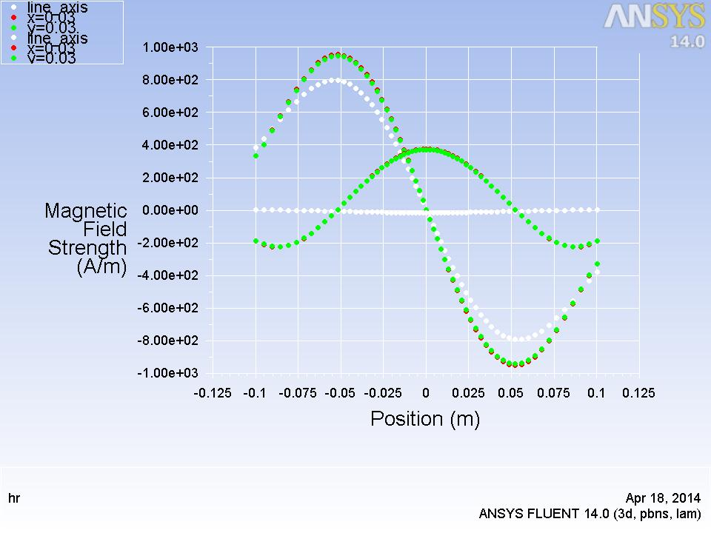
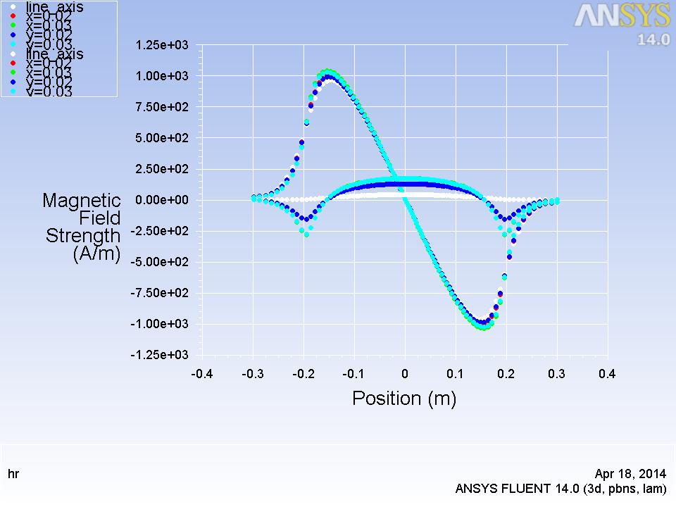
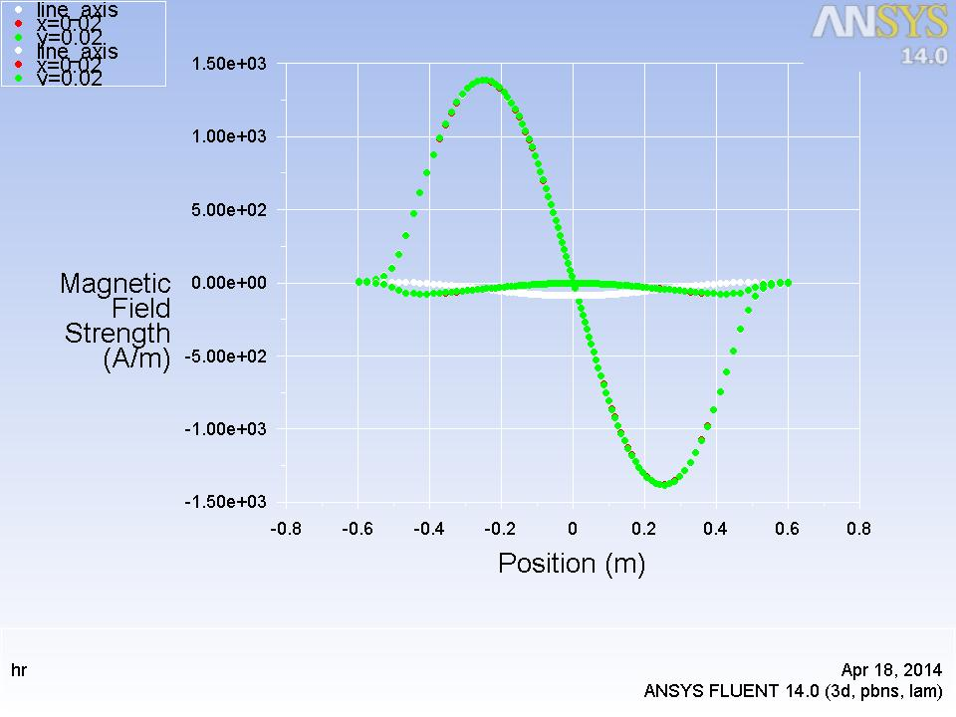
Solenoid Space Varying Current
(a)
L/R = 5
(b)
L/R = 10
H_{z}
H_{z}
H_{r}
(c)
L/R = 25
H_{z}
H_{r}
Notes:
Increase in magnitude of Hz

Slide 23
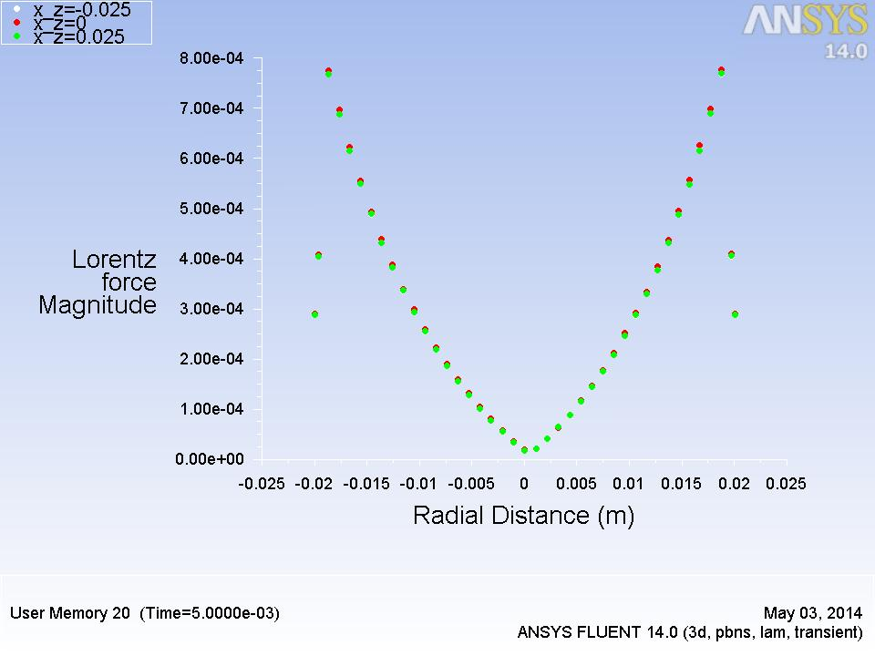
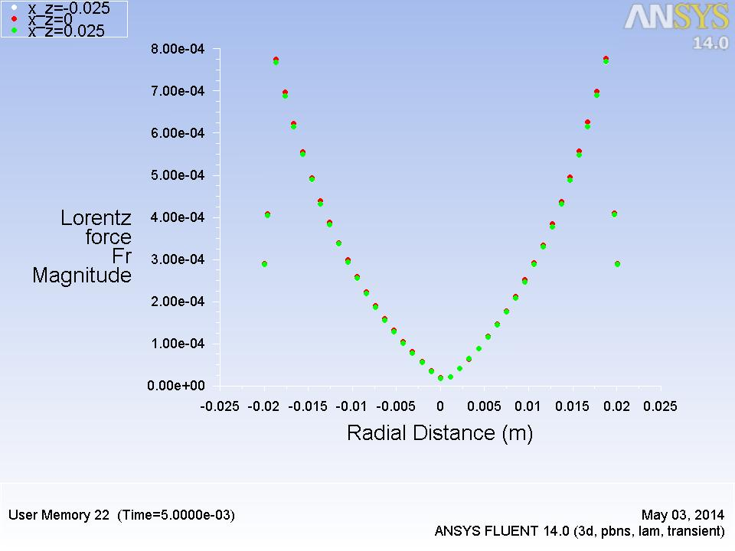
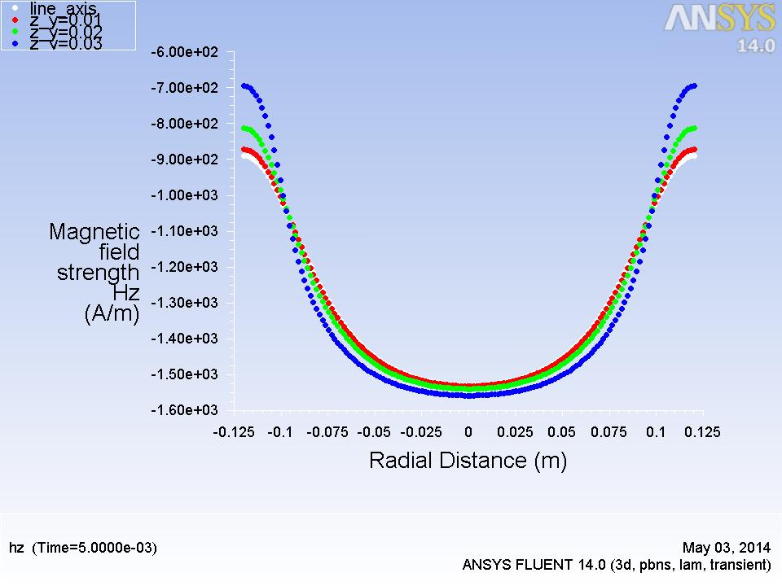
Solenoid -Time Varying current
(a)
(b)
Radial variation of Lorentz force magnitude
Radial variation of F_{r}
(c) Axial variation of H_{z}
(c)
Notes:
F mag nearly equal to Fr mag

Slide 24
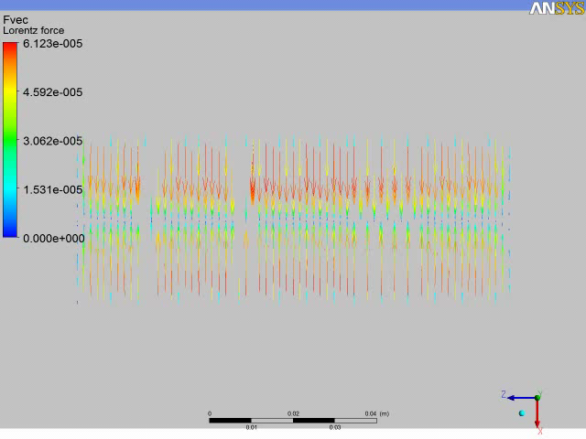
Solenoid – Time Varying (contd)

Slide 25
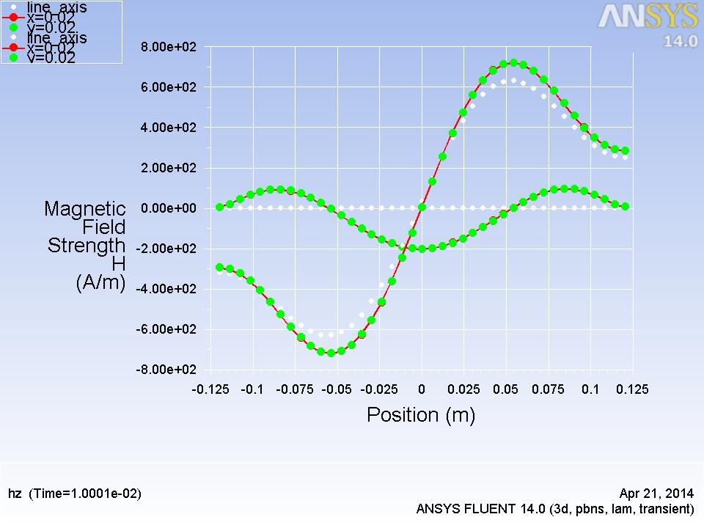
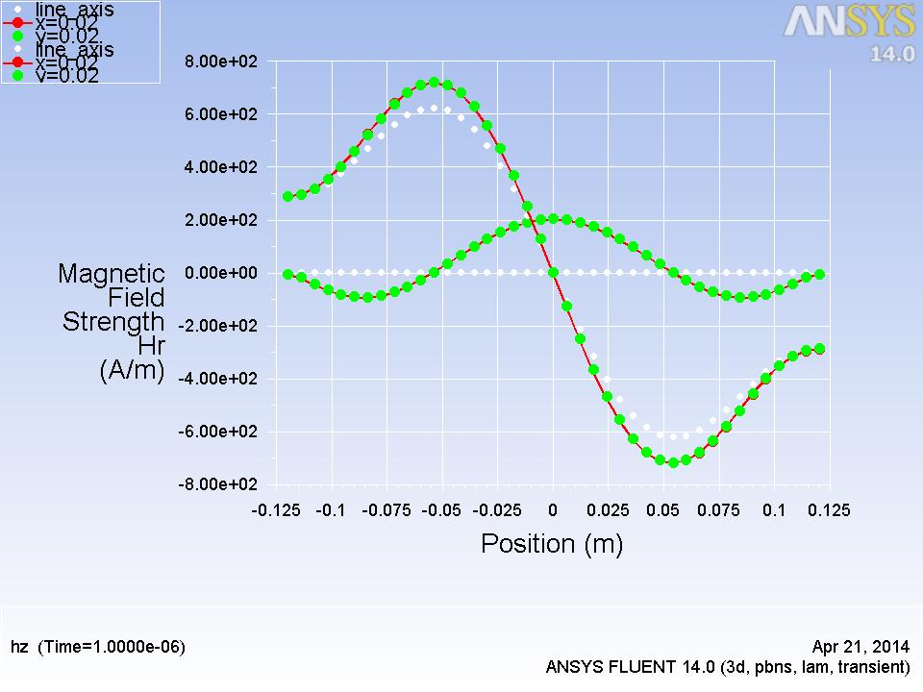
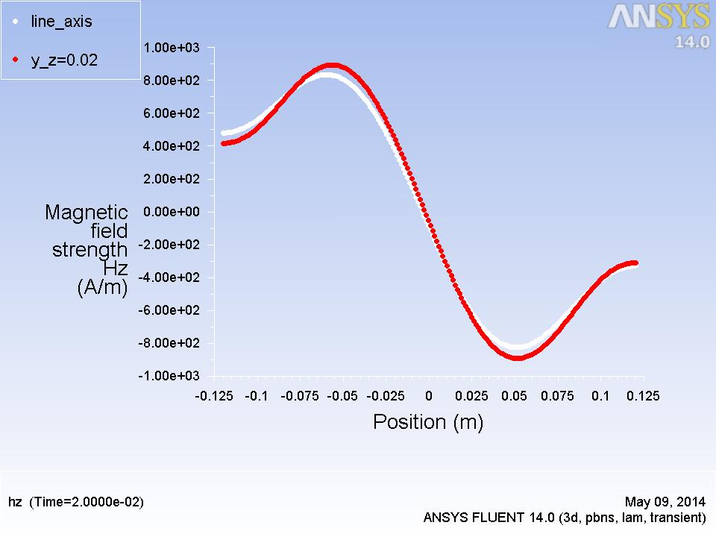
Solenoid – Space and Time Varying
(a)
H_{z}
H_{z}
H_{r}
H_{r}
(b)
Axial Variation of magnetic field strength at t= 1e-6 s
Axial Variation of magnetic field strength at t= 0.01 s
Axial Variation of magnetic field strength at t= 0.02 s
H_{z}
(c)

Slide 26
Inferences
A space and time varying field is needed to generate Lorentz forces which cause stirring
A single phase space and time varying field creates Lorentz forces which vary in direction over one cycle.
Three phase currents are required to produce Lorentz forces which are in same direction over one cycle.

Slide 27
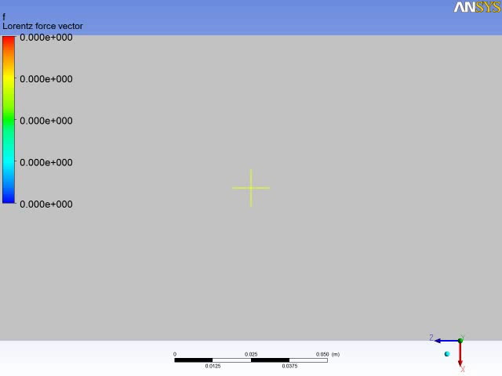
Development of LEMS – 3 coils

Slide 28
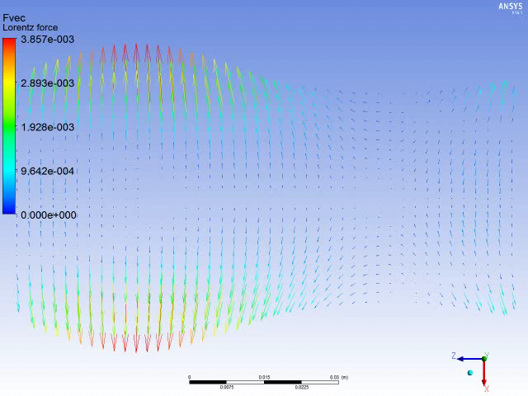
Design of LEMS – 6 coils

Slide 29
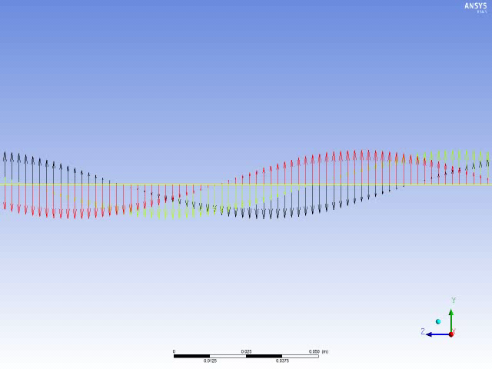
Design of LEMS – 6 coils

Slide 30
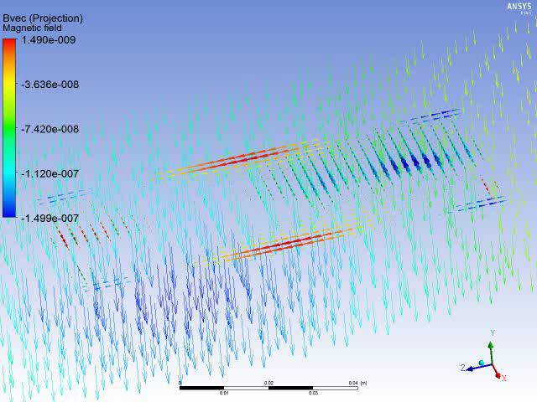
Generation of Axial force in LEMS

Slide 31
Conclusions
Field formulation for electromagnetic problems
User Defined functions in ANSYS FLUENT to implement field formulations
Validating field formulations for simple electromagnetic problems
Design of Linear Electromagnetic Stirrer

Slide 32
Scope
Modeling Magnetic Return Paths which concentrate flux lines insider the stirrer
Studying fluid flow in LEMS
Implementing Solidification and Melting module to study phase change

Slide 33
Thank You!

